Slide 1
Making (console) games in the browser
Mike Acton (Insomniac Games)
TWItter @mike_acton

Slide 2

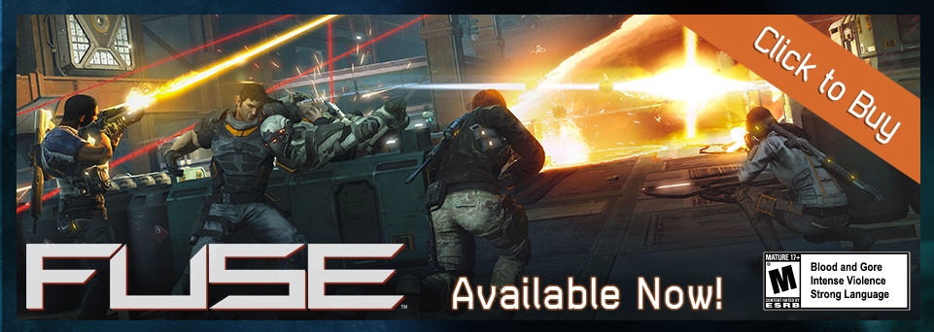

Slide 3
Started 2010…

Slide 4
Why?

Slide 5
Why?
Native
Vs
Browser

Slide 6
Inevitability

Slide 7
Inevitability
UX and UI Research

Slide 8
Inevitability
UX and UI Research
Forcing function (data separation)

Slide 9
…but mostly a bet on the future

Slide 10
How do we use the browser?

Slide 11
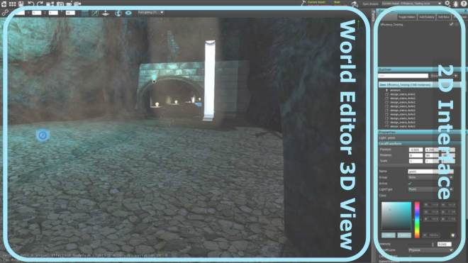

Slide 12
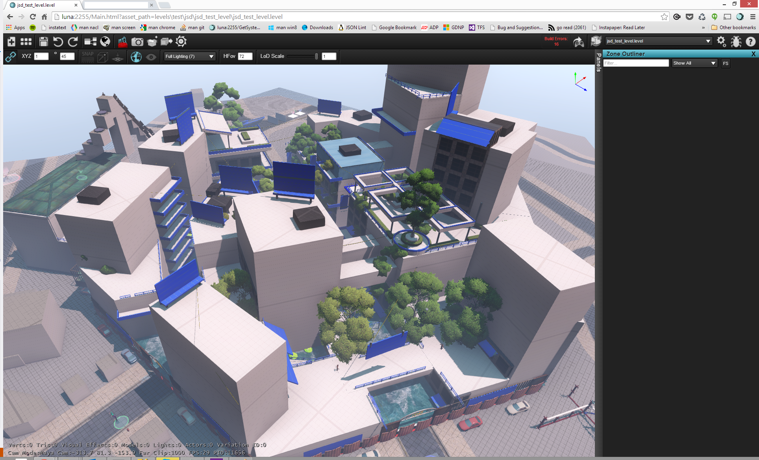

Slide 13
Chrome only
--harmony (ECMAScript 6)

Slide 14
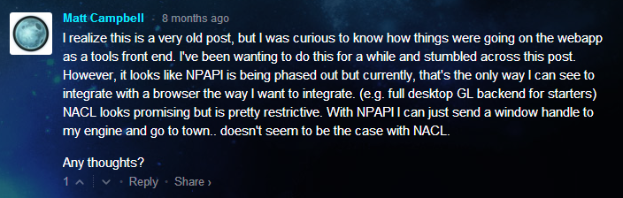
Chrome only
--harmony (ECMAScript 6)
:(

Slide 15
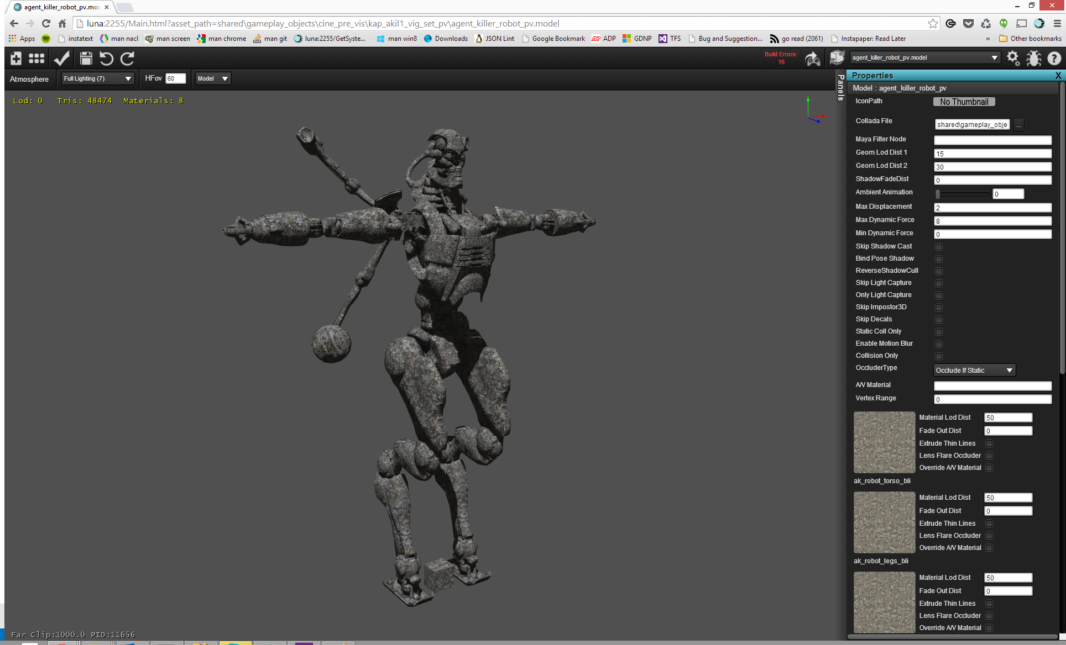
Model Editor

Slide 16
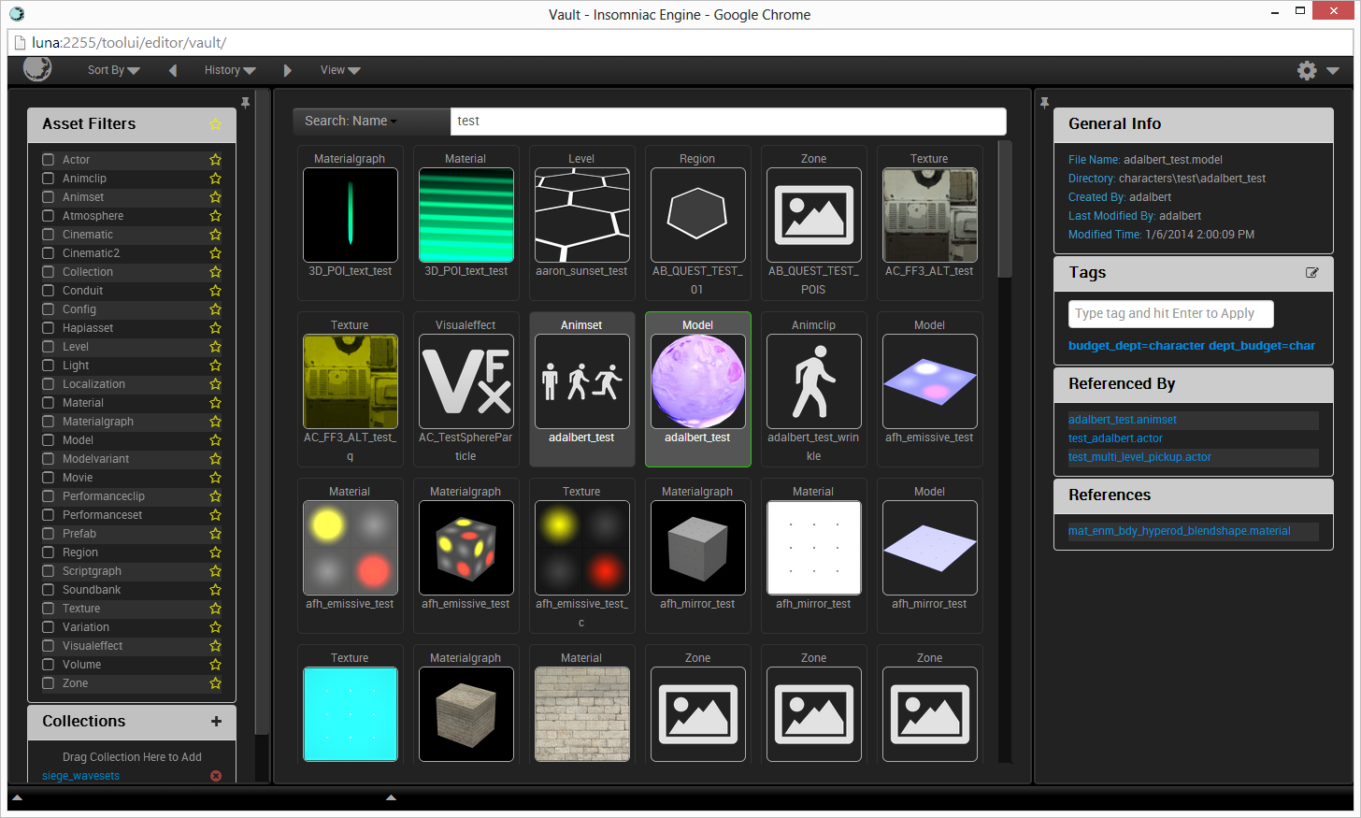
Vault

Slide 17
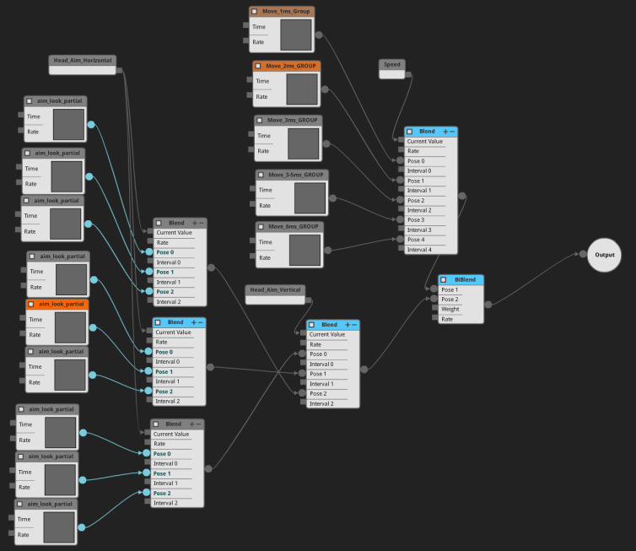
Anim Driver Editor

Slide 18
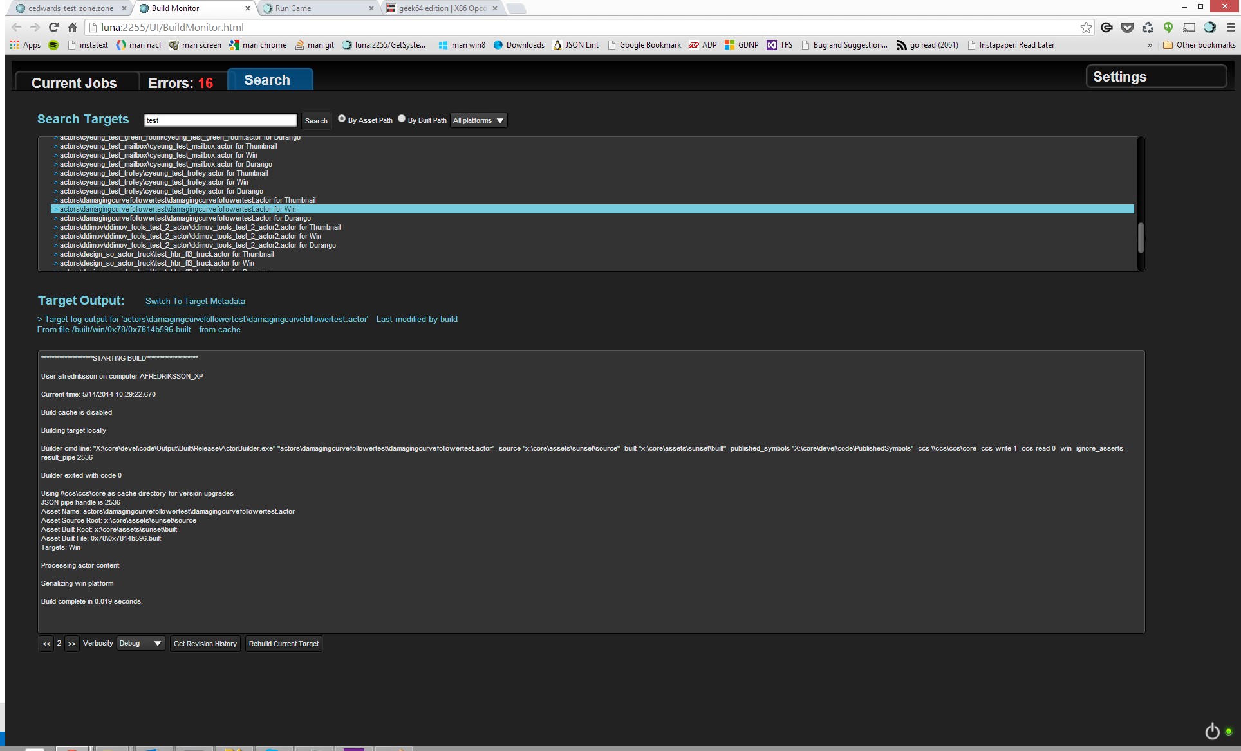
Build Monitor

Slide 19
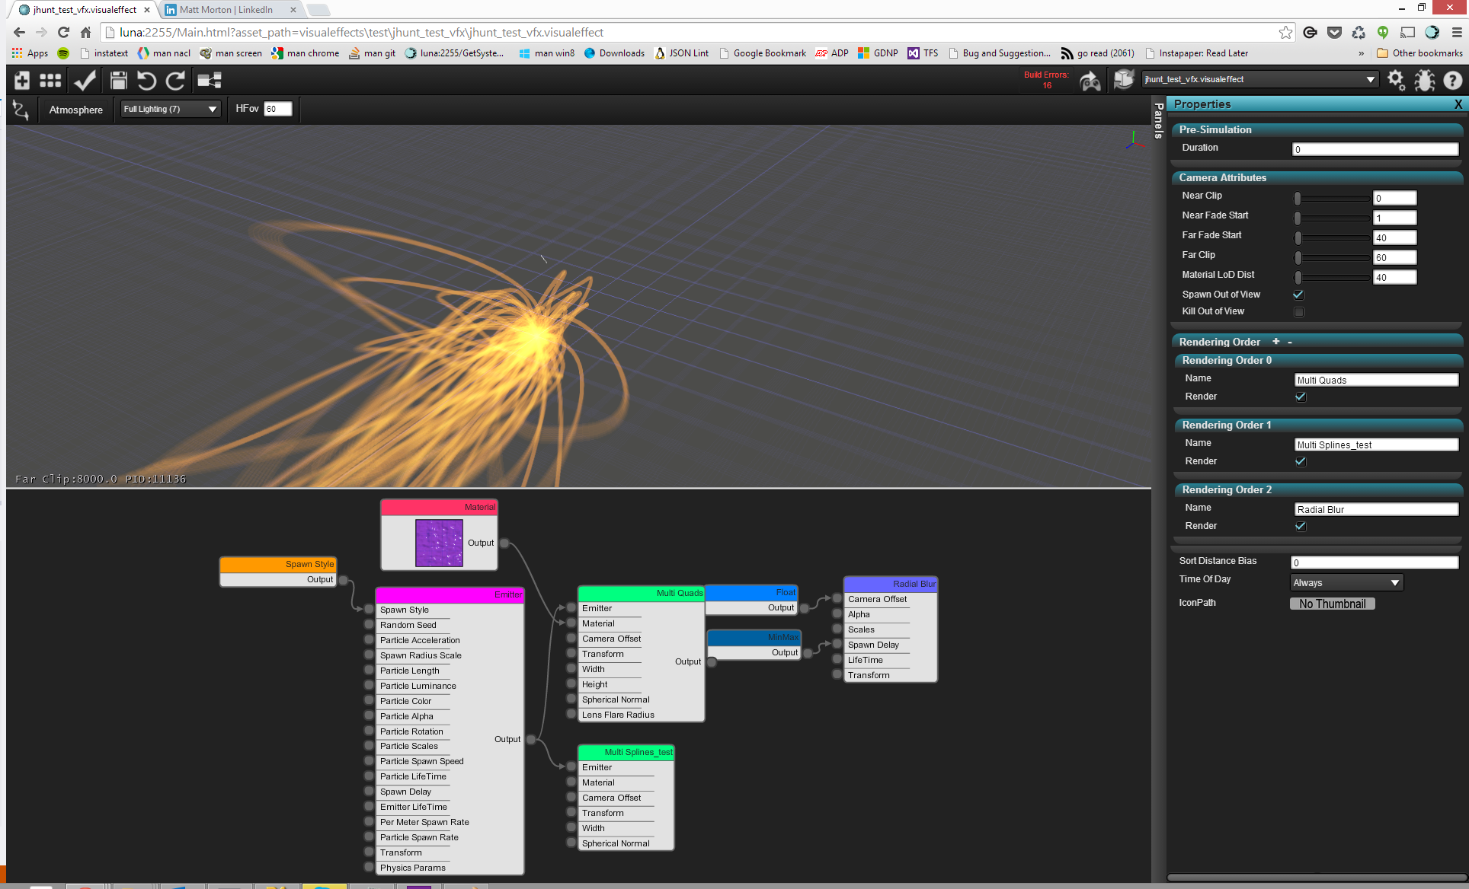
Particle Editor

Slide 20
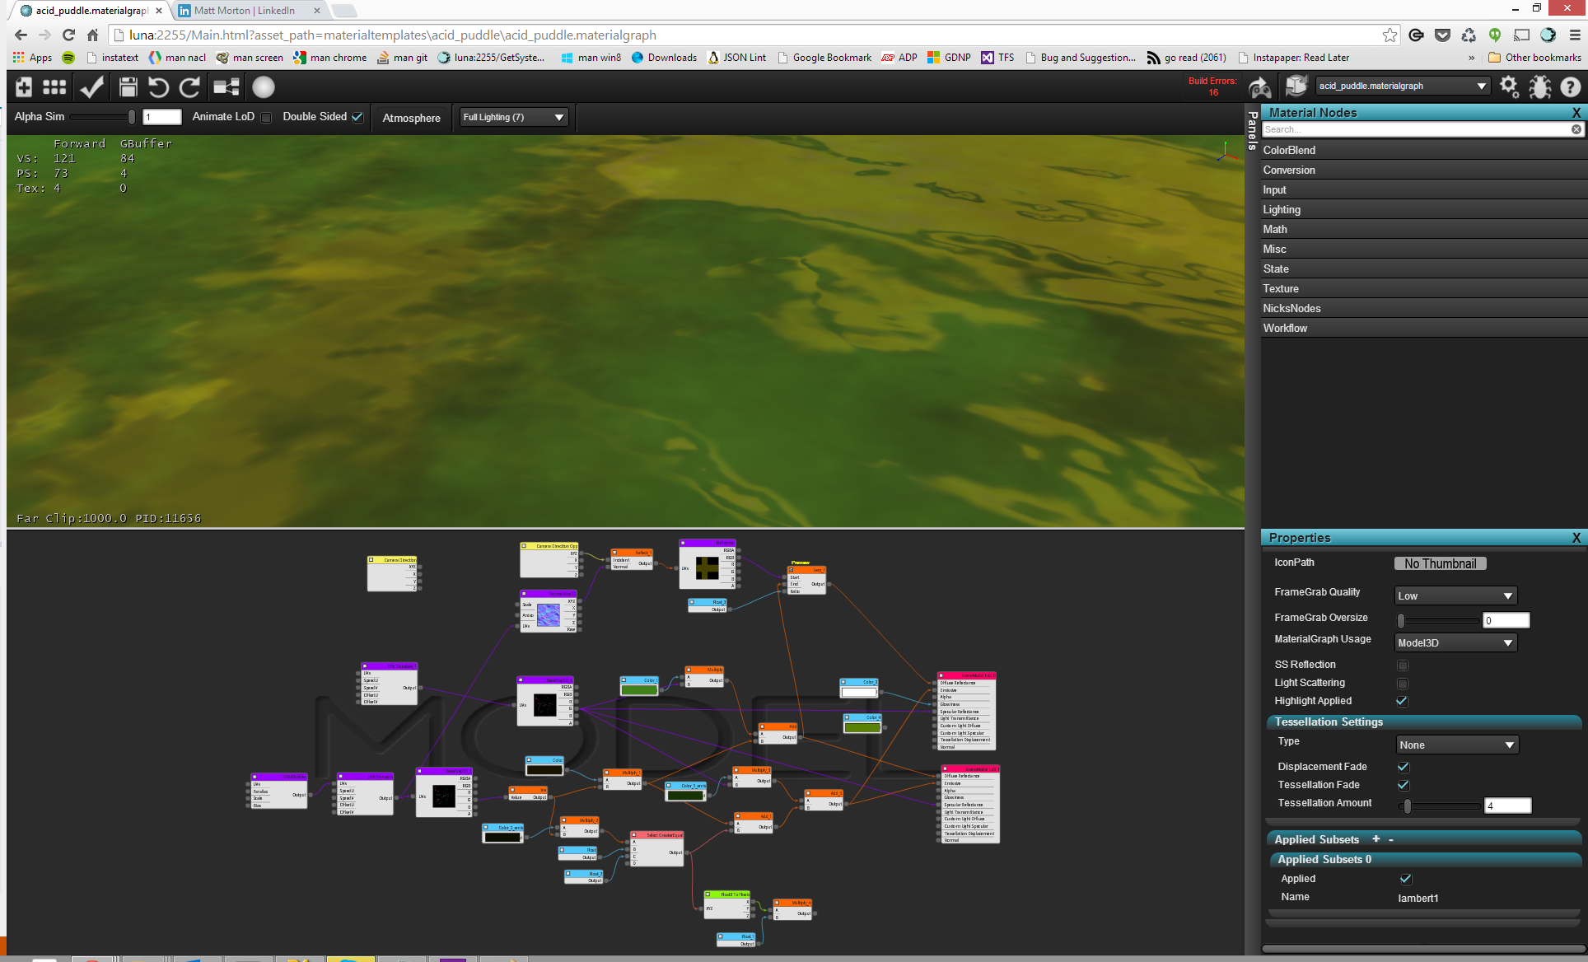
Material Editor

Slide 21
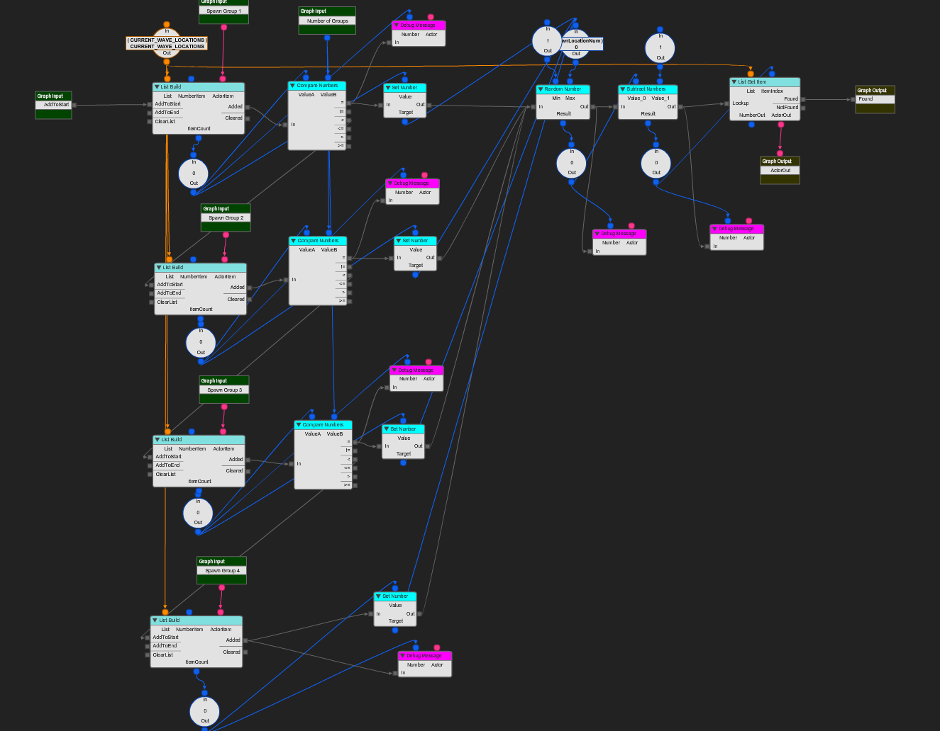
Script Editor

Slide 22
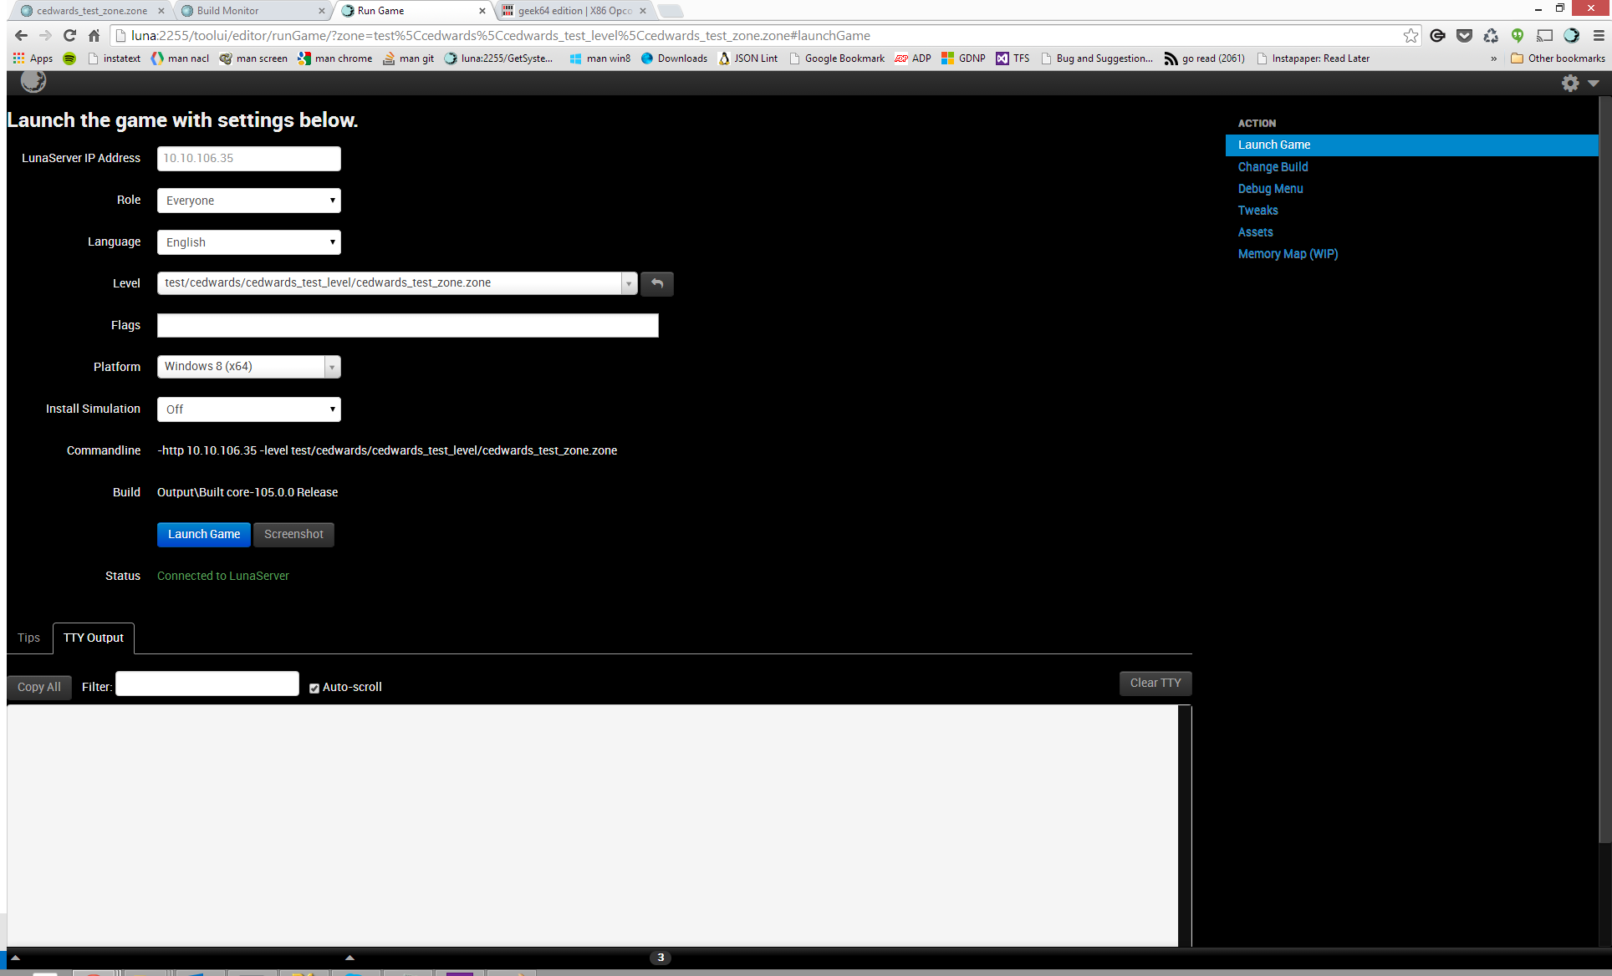
Run Game

Slide 23
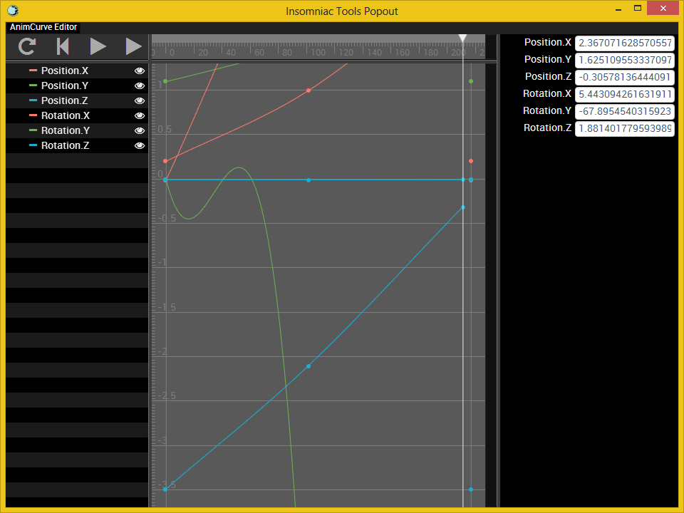
Curve Editor
Notes:
Repeat for additional keys

Slide 24
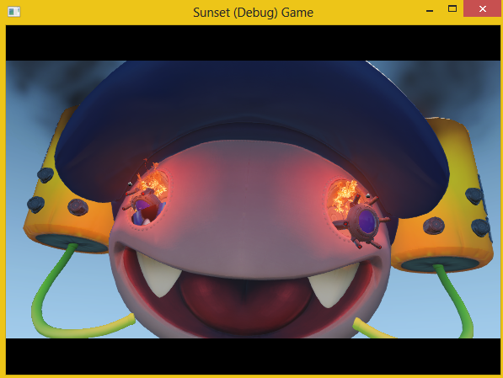
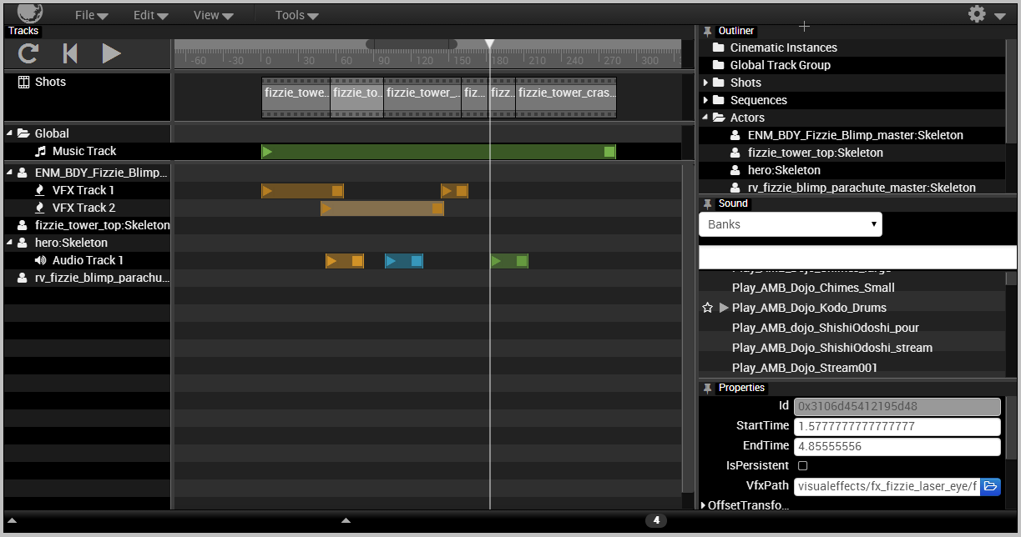
cinematic2
Notes:
here’s the new cinematics editor

Slide 25
cinematic2
game view (it *is* the game – running all update code)
Notes:
game view (it *is* the game – running all update code)

Slide 26
cinematic2
the outliner – shows everything in the cinematic
Notes:
the outliner – similar to the scene editor – shows everything in the cinematic

Slide 27
cinematic2
sound panel – search / create favorites / audition events
Notes:
sound panel (shows all sound banks and sound events) – search / create favorites / audition events

Slide 28
cinematic2
properties panel (for currently selected thing)
Notes:
properties panel (for currently selected thing)

Slide 29
cinematic2
timeline and playback control
Notes:
timeline and playback controll

Slide 30
cinematic2
shots list (can be edited and rearranged)
Notes:
shots list (can be edited and rearranged)

Slide 31
cinematic2
tracks list
Notes:
tracks list

Slide 32
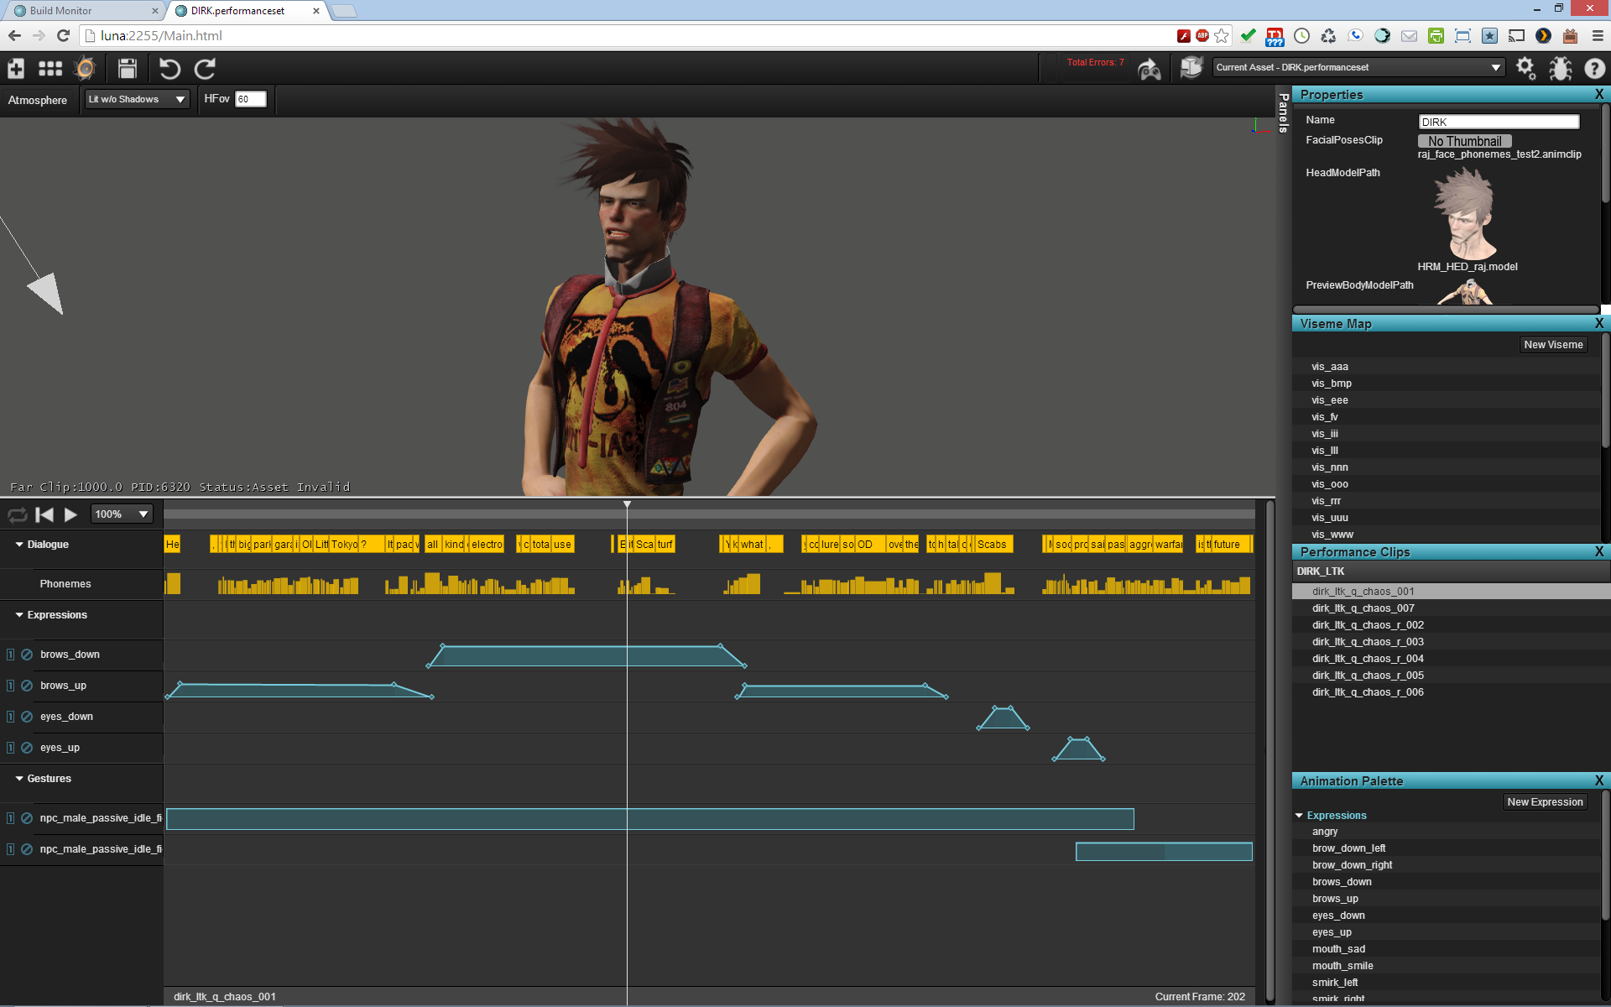
performance editor
Notes:
use performance editor to set up the performance (will be integrated into cinematics editor next project)

Slide 33
performance editor
3d view
Notes:
3d view

Slide 34
performance editor
clips in the performance set
Notes:
clips in the performance set

Slide 35
performance editor
animation palette (expressions + gestures)
Notes:
animation palette (expressions + gestures)

Slide 36
performance editor
phoneme -> viseme map
Notes:
phoneme -> viseme map

Slide 37
performance editor
timeline
Notes:
timeline

Slide 38
performance editor
phonemes (automatically generated)
Notes:
phonemes (automatically generated)

Slide 39
performance editor
expressions
Notes:
expressions

Slide 40
performance editor
gestures
Notes:
gestures

Slide 41
What libs do we use?

Slide 42
What libs do we use?
Jquery (less and less)

Slide 43
What libs do we use?
Jquery (less and less)
Angular.js (directives good; complexity/obfuscation bad)

Slide 44
What libs do we use?
Jquery (less and less)
Angular.js (directives good; complexity/obfuscation bad)
Q.js (good)

Slide 45
What libs do we use?
Jquery (less and less)
Angular.js (directives good; complexity/obfuscation bad)
Q.js (good)
Require.js (good)

Slide 46
What libs do we use?
Jquery (less and less)
Angular.js (directives good; complexity/obfuscation bad)
Q.js (good)
Require.js (good)
Bootstrap (OK)

Slide 47
What libs do we use?
Jquery (less and less)
Angular.js (directives good; complexity/obfuscation bad)
Q.js (good)
Require.js (good)
Bootstrap (OK)
WebGL? (no)

Slide 48
How do we put it together?

Slide 49
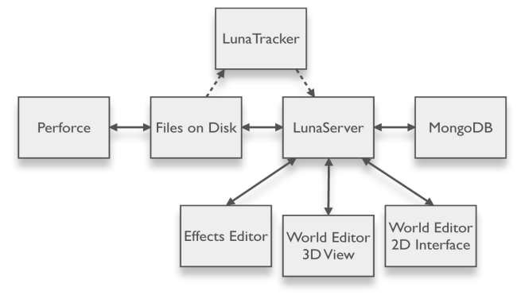

Slide 51
LunaServer
Native Application (C++) – mongoose server

Slide 52
LunaServer
Native Application (C++) – mongoose server
RESTful (*ish) API

Slide 53
LunaServer
Native Application (C++) – mongoose server
RESTful (*ish) API
File I/O

Slide 54
LunaServer
Native Application (C++) – mongoose server
RESTful (*ish) API
File I/O
P4 integration

Slide 55
LunaServer
Native Application (C++) – mongoose server
RESTful (*ish) API
File I/O
P4 integration
Session management

Slide 56
LunaServer
Native Application (C++) – mongoose server
RESTful (*ish) API
File I/O
P4 integration
Session management
Undo/Redo

Slide 57
LunaServer
Native Application (C++) – mongoose server
RESTful (*ish) API
File I/O
P4 integration
Session management
Undo/Redo
File/Asset save/edit/revert

Slide 58
LunaServer
Native Application (C++) – mongoose server
RESTful (*ish) API
File I/O
P4 integration
Session management
Undo/Redo
File/Asset save/edit/revert
System and configuration information

Slide 59
LunaServer
Native Application (C++) – mongoose server
RESTful (*ish) API
File I/O
P4 integration
Session management
Undo/Redo
File/Asset save/edit/revert
System and configuration information
Crash proofing

Slide 60
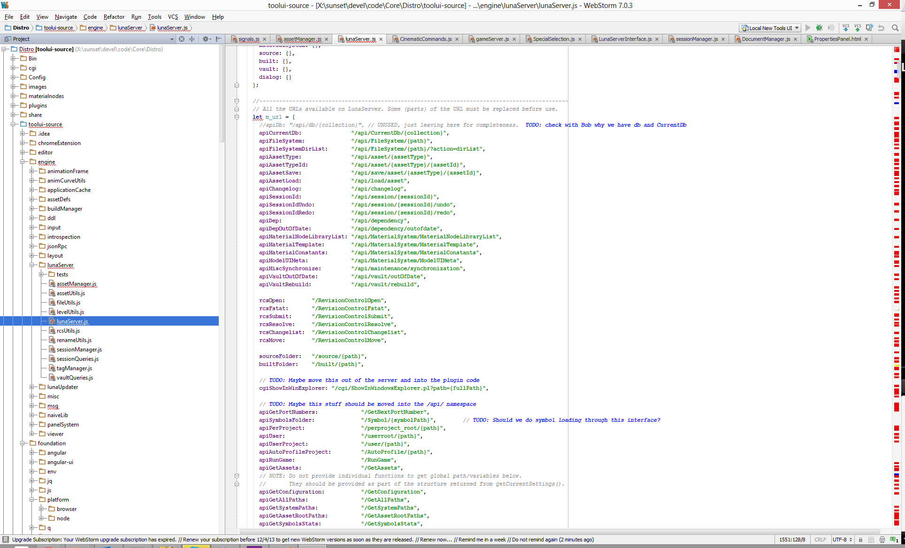

Slide 61
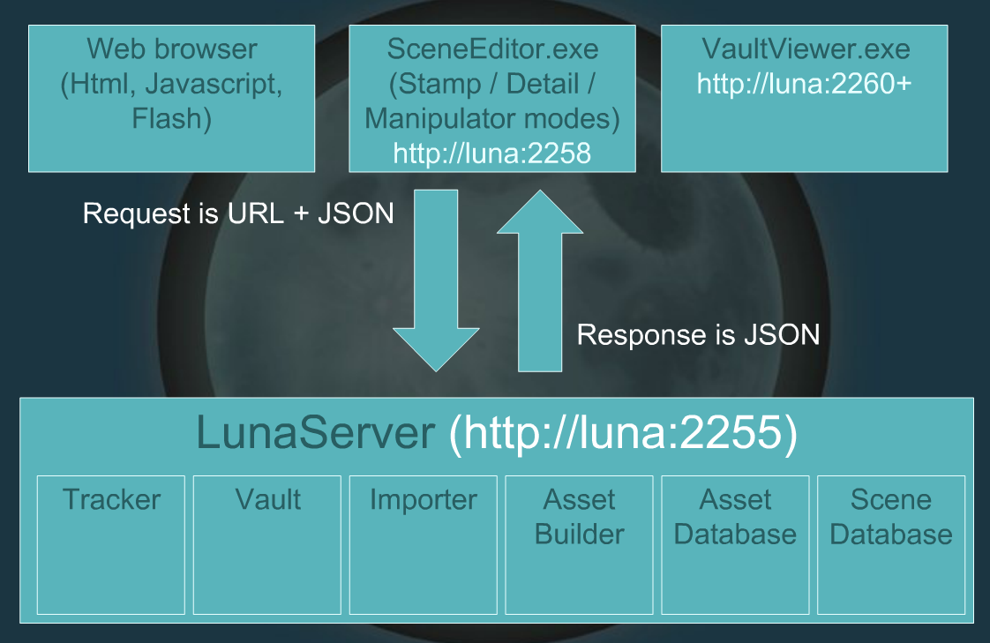
LunaServer (JSON)

Slide 62
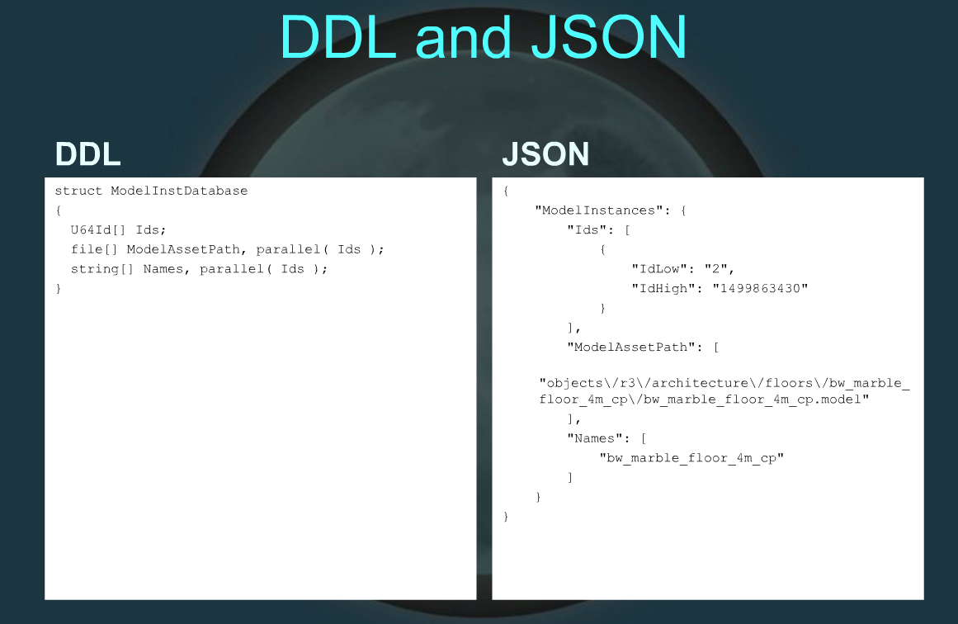
LunaServer (JSON)

Slide 63
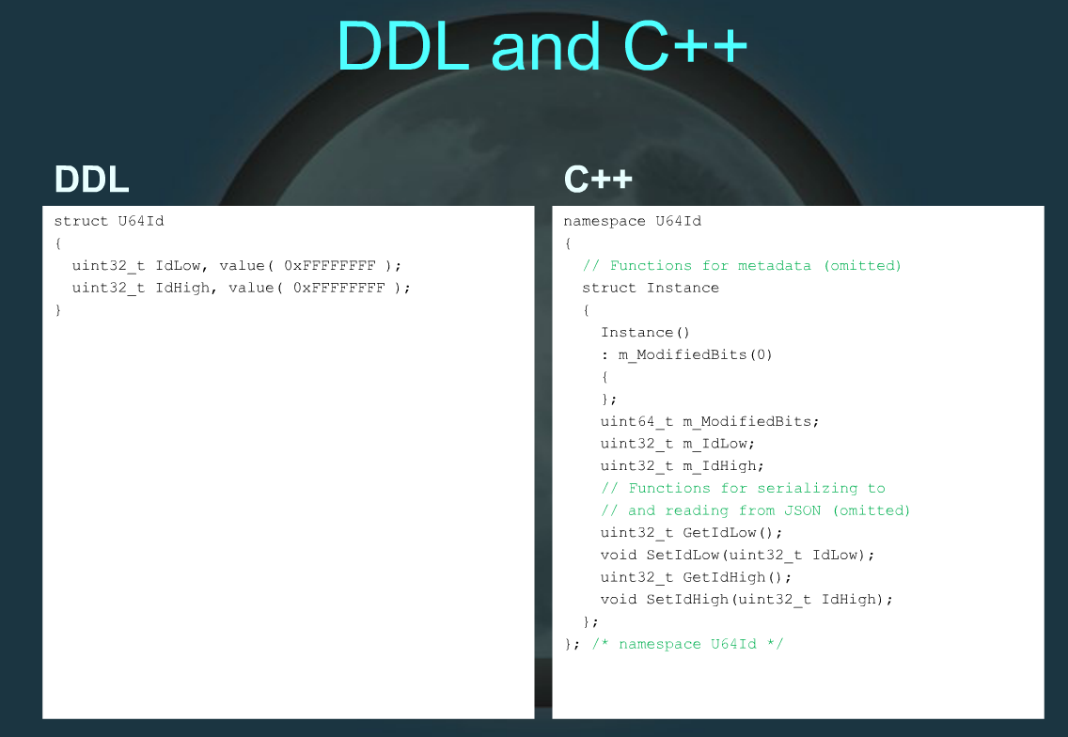
LunaServer (JSON)

Slide 64
DDLC
Compiler -> JSON, C++, etc.

Slide 65
DDLC
Compiler -> JSON, C++, etc.
Node.js script (ejs)

Slide 66
DDLC
Compiler -> JSON, C++, etc.
Node.js script (ejs)
(used to be native application)

Slide 67
DDLC
Compiler -> JSON, C++, etc.
Node.js script (ejs)
(used to be native application)
ddl.js (captures communication to lunaserver)

Slide 68
Vault

Slide 69
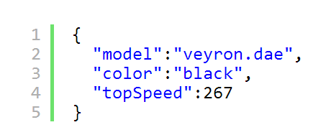
Delta JSON

Slide 70
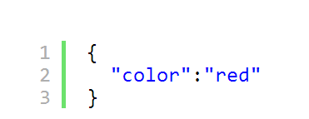
Delta JSON

Slide 71
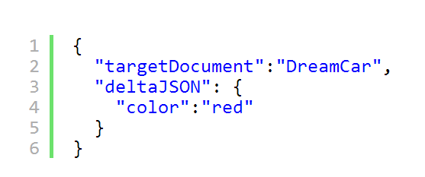
Delta JSON

Slide 72
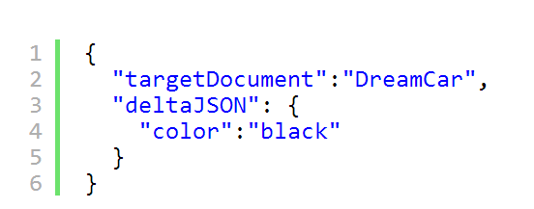
Delta JSON
(undo/redo)

Slide 73
Model Editor

Slide 74
Data change -> ddl.js
-> delta json

Slide 75
/api/save/asset/{assetType}/{assetId}

Slide 76
Current state, undo queue

Slide 77
Canonical asset change

Slide 78
Picks up change
(triggers builder)

Slide 80
Game
(as client)
Requests native built file

Slide 81
Polls for changes

Slide 82
What’s newer?

Slide 83
Node.js scripts

Slide 84
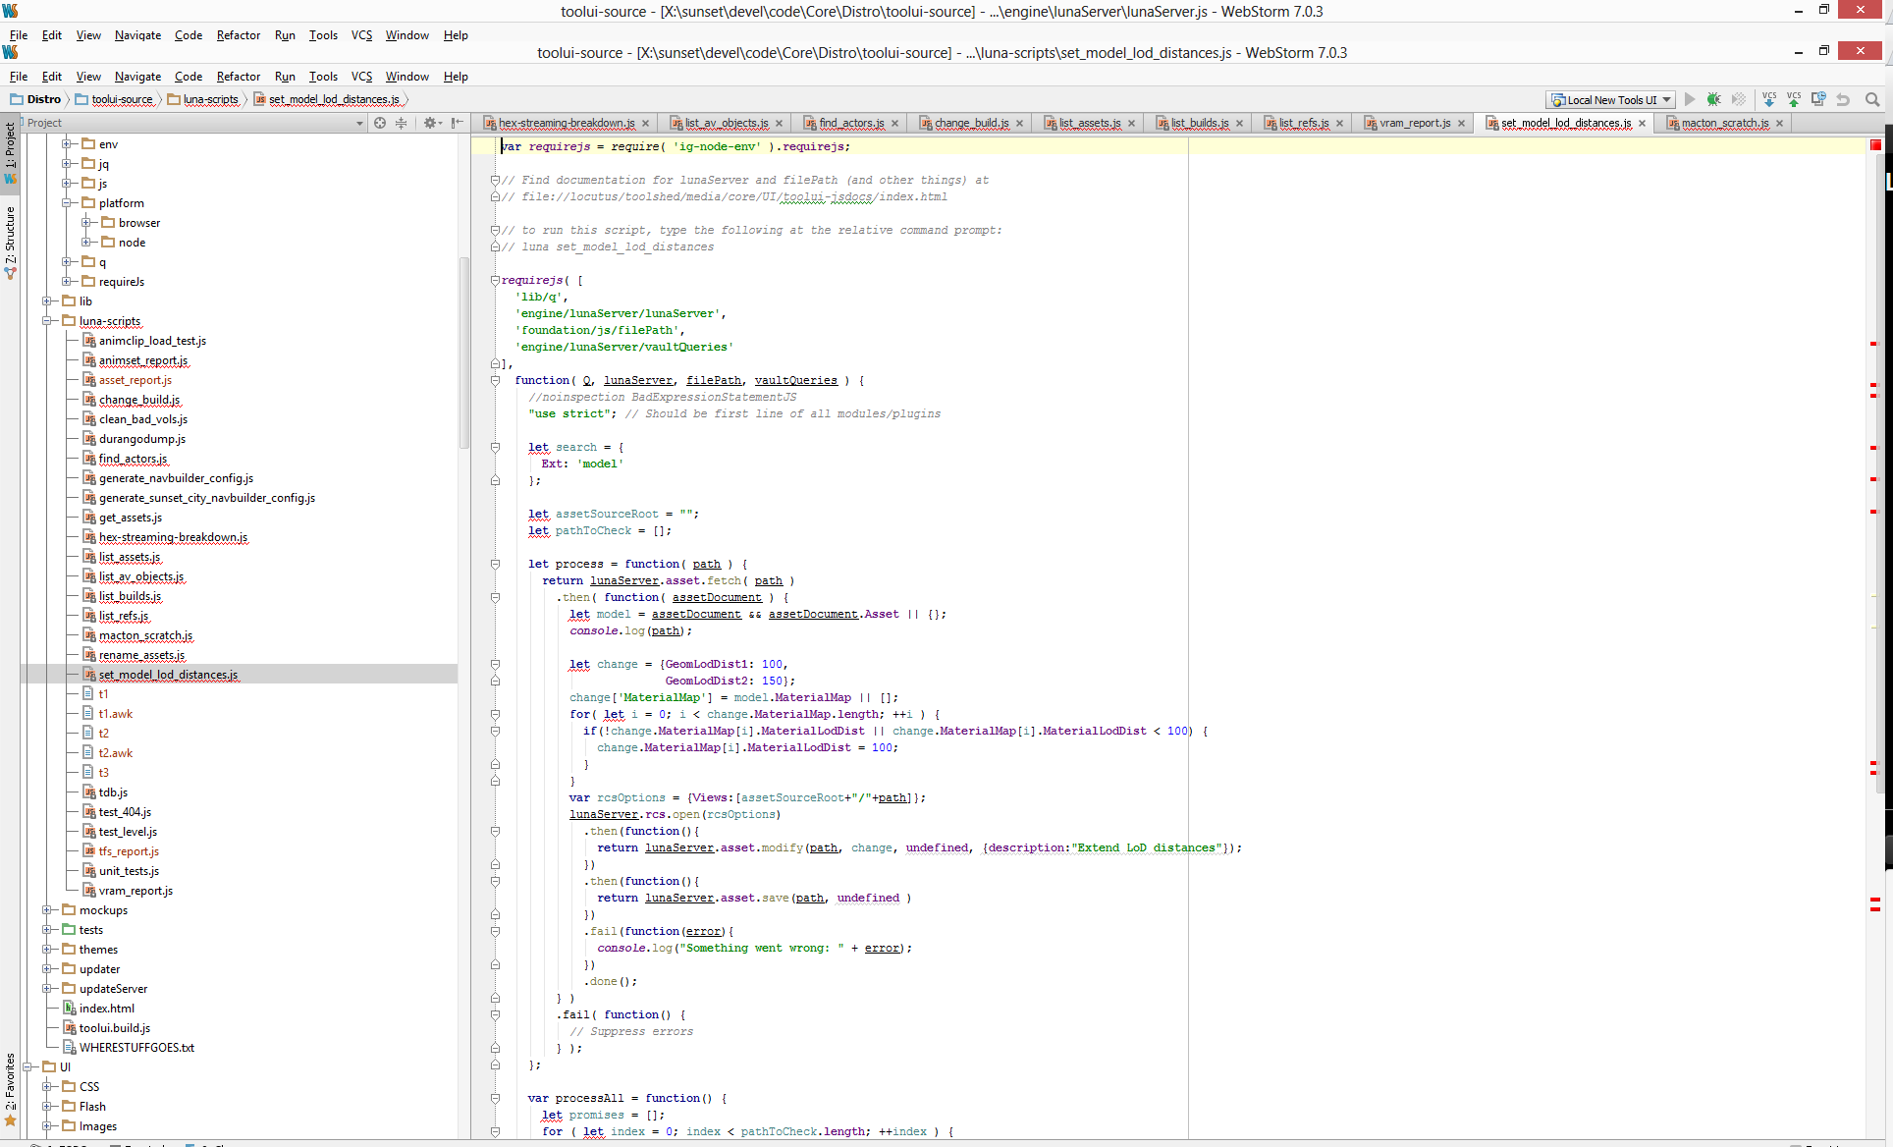

Slide 85
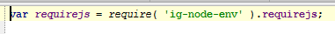
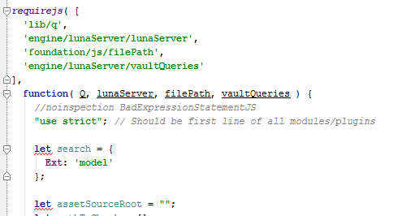
Shared code between node.js and browser

Slide 86
Node.js scripts
Game
(JsonRPC)

Slide 87
Node.js scripts
Game
(JsonRPC)
Game
(RESTful server)

Slide 88
Node.js scripts
Game
(JsonRPC)
Game
(RESTful server)

Slide 89
Game
(as client)
Node.js scripts
Game
(JsonRPC)
Game
(RESTful server)

Slide 90
FAQ#1
File-backed vs DB assets

Slide 91
FAQ#2
WebSockets

Slide 92
UI (javascript) guidelines

Slide 93
UI (javascript) guidelines
Custom controls

Slide 94
Custom controls
DDL (specific)

Slide 95
ddl.js
Custom controls
Custom rules specific to data (constraints)
DDL (specific)

Slide 96
ddl.js
Custom controls
Custom rules specific to data (constraints)
DDL (specific)
Control (Source)

Slide 97
ddl.js
Custom controls
Custom rules specific to data (constraints)
DDL (specific)
Control (Source)
Control (Widget)

Slide 98
ddl.js
Custom controls
Custom rules specific to data (constraints)
DDL (specific)
Control (Source)
Control (Widget)
Custom Control
Custom Control Group (Manager)

Slide 99
ddl.js
Custom controls
Custom rules specific to data (constraints)
DDL (specific)
Control (Source)
Control (Widget)
Custom Control
Custom Control Group (Manager)

Slide 100
ddl.js
Custom controls
Custom rules specific to data (constraints)
DDL (specific)
Control (Source)
Control (Widget)
Custom Control
Custom Control Group (Manager)

Slide 101
ddl.js
Custom controls
Custom rules specific to data (constraints)
DDL (specific)
Control (Source)
Control (Widget)
Custom Control
Custom Control Group (Manager)
Node.js

Slide 102
UI (javascript) guidelines
Editing DOM

Slide 103
Editing DOM
#1 Minimize editing DOM!

Slide 104
Editing DOM
#1 Minimize editing DOM!
Group DOM edits into AnimationFrame callback

Slide 105
Editing DOM
#1 Minimize editing DOM!
Group DOM edits into AnimationFrame callback
Minimize jquery

Slide 106
Editing DOM
#1 Minimize editing DOM!
Group DOM edits into AnimationFrame callback
Minimize jquery
jQuery accesses the DOM all the time

Slide 107
Editing DOM
#1 Minimize editing DOM!
Group DOM edits into AnimationFrame callback
Minimize jquery
jQuery accesses the DOM all the time
Store selector results if you must use a selector

Slide 108
Editing DOM
#1 Minimize editing DOM!
Group DOM edits into AnimationFrame callback
Minimize jquery
jQuery accesses the DOM all the time
Store selector results if you must use a selector
Minimize angular

Slide 109
Editing DOM
#1 Minimize editing DOM!
Group DOM edits into AnimationFrame callback
Minimize jquery
jQuery accesses the DOM all the time
Store selector results if you must use a selector
Minimize angular
When does it create the DOM?

Slide 110
FAQ#3
Control Libraries?

Slide 111
UI (javascript) guidelines
Complexity

Slide 112
UI Complexity / Cost
Don’t underestimate
it!

Slide 113
2010…2014+

Slide 114
Q&A

